Slide 1
Purpose
Conduct NCO Professional Development to strengthen Noncommissioned Officer competencies
Leader Development
Coaching Session
Agenda
Topics –
Army Writing
Awards
Evaluations
Memorandums
Email

Slide 2
References
DA Pam 623-3: Evaluation Reporting System, dated 27 Sep 19
AR 623-3: Evaluation Reporting System, dated 14 Jun 19
ATP 6-22.1 –The Counseling Process, dated 1 Jul 14

Slide 3
The NCOER begins with counseling
Initial (providing rated NCO rater and senior rater support forms)
Quarterly
Event specific (failures, accomplishments)
Deliberate process
Schedule time
Notify Soldier for review & input
Merit based document
Remember your audience
Leadership
Branch managers
DA Centralized Boards
Proponent Managers
Consider impact on the NCO’s career

Slide 4
Bullets
5 Area’s – 3 Bullets each
Did Not Meet Standard
Rated NCO fails to meet or maintain the required Army standards and organizational goals of leader competencies and attributes; does not enforce or meet the standard for the unit or those in his or her charge; exhibits or displays minimal or no effort; actions often have a negative effect on the mission, their Soldiers, the unit, and the Army.
Met Standard
Rated NCO successfully achieves and maintains the required Army standards and organizational goals of leader competencies and attributes; effectively meets and enforces the standard for the unit and those in his or her charge; succeeds by taking appropriate initiative in applying the leader competencies and attributes; results have a positive impact on the mission, their Soldiers, the unit, and the Army; this level of performance is considered normal and typically demonstrated by a majority of NCOs of the same grade.
Reference: DA PAM 623-3 (3-11)

Slide 5
5 Area’s – 3 Bullets each
Exceeded Standard
Rated NCO performs above the required Army standards and organizational goals of leader competencies and attributes; this NCO and his or her Soldiers often take disciplined initiative in applying leader competencies and attributes; results have an immediate impact on the mission, their Soldiers, the unit, and the Army; this level of performance is not common, typically demonstrated by the upper third of NCOs of the same grade.
Reference: DA PAM 623-3 (3-11)

Slide 6
5 Area’s – 3 Bullets each
Far Exceeded Standard
Rated NCO performs extraordinarily above the required Army standards and organizational goals of leader competencies and attributes; leadership enables Soldiers and unit to far surpass required organizational and Army standards; demonstrated performance epitomizes excellence in all aspects; this NCO and his or her Soldiers consistently take disciplined initiative in applying leader competencies and attributes; results have an immediate impact and enduring effect on the mission, their Soldiers, the unit, and the Army; demonstrated by the best of the upper third of NCOs of the same grade.
Reference: DA PAM 623-3 (3-11)

Slide 7
So What …
What?
(what the NCO did)
So what?
(how he/she did it, how many times, etc.)
Which means
(result of what they did)
Therefore
(professional implication of what they did)

Slide 8
So What …
What?
So what?
Which means
Therefore
What the rating officials write
What a board will understand

Slide 9
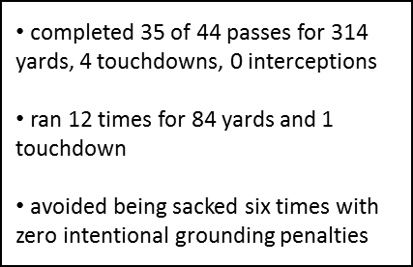
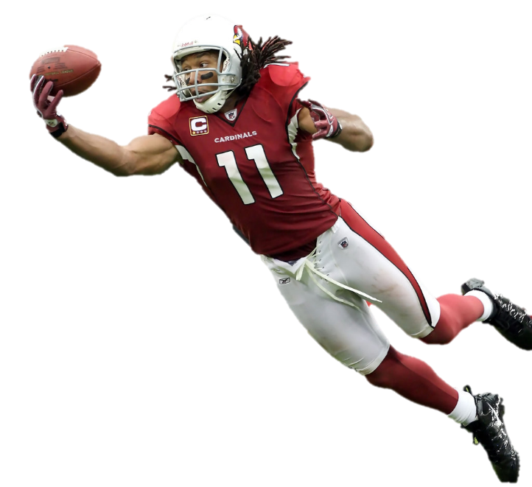
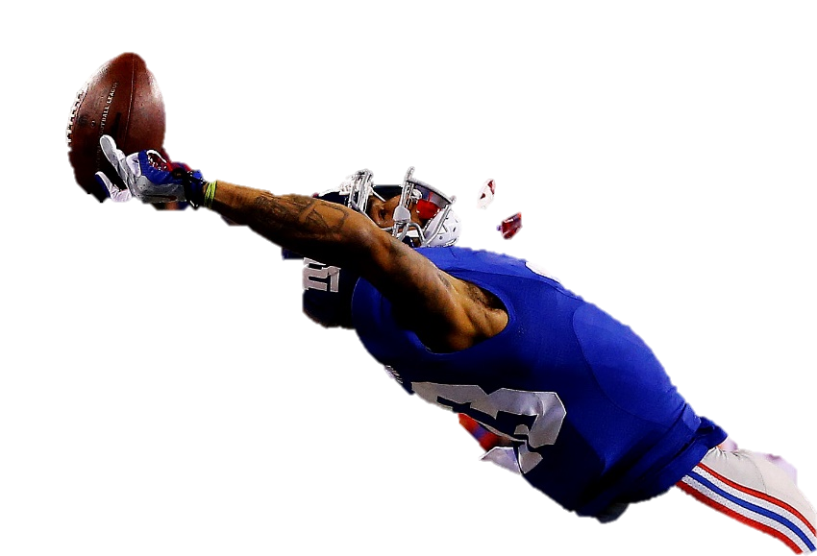
So What …
What?
So what?
Which means
Therefore
The conclusion DA centralized board members will draw from the NCOER will depend on what is written

Slide 10
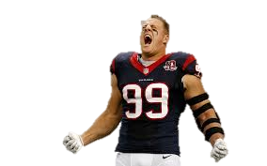
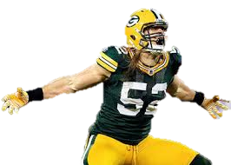
Strong Verbiage
This is an example of the active voice because the sentence subject p
Active -v- Passive Voice
Passive Voice
Active Voice
active voice is a type of a clause or sentence in which a subject performs an action and expresses it through its representative verb. To simply put it, when a subject performs an action directly, it is in active voice.
examples show that the subject is doing the verb's action. Because the subject does or "acts upon" the verb in such sentences, the sentences are said to be in the active voice.

Slide 11
Strong Verbiage
Specific .vs. General
General (Qualitative)
Specific (Quantitative)
fostered team spirit and positive attitude
strong, physically fit member of the team
set the example for the other defensive players to follow
recognized by the league as an exceptional defensive player
built esprit de corps by leading 30 man team at warm up drills before 18 games and practices
organized 20 additional gym hours per week outside of practice
led defense with 34 tackles
named defensive player of the week seven times during the season

Slide 12
Bullets …. continued
volunteered 40 community service hours; provided support to the Rolla Veterans Center during morale and welfare activities
Far Exceeded Standard
promoted team unity and physically fit Soldiers during PRT; resulted in a 95% pass rate during final APFT
Met/Exceeded Standard
earned 298 APFT score; used fitness skills to motivate Soldiers during PRT sessions 34 earned physical fitness badge of excellence
Far Exceeded Standard

Slide 13
Bullets … continued
Which would be a “Far Exceeded Standard”?
Met Standard
Exceeded Standard
Far Exceeded Standard
threw 44 passes during the game
ran the ball when needed
avoided being sacked
completed 35 of 44 passes
ran 12 times for 84 yards
avoided being sacked six times
completed 35 of 44 passes for 314 yards, 4 touchdowns, 0 interceptions
ran 12 times for 84 yards and 1 touchdown
avoided being sacked six times with zero intentional grounding penalties

Slide 14
Strong Verbiage
Match the Category
PRESENCE: (Military and professional bearing, Fitness, Confidence, Resilience)
spearheaded the defense in reviewing the film for each upcoming opponent
INTELLECT: (Mental agility, Sound judgment, Innovation, Interpersonal tact, Expertise)
took time to mentor new players to help ensure their success
LEADS: (Leads others, Builds trust, Extends influence beyond the chain of command, Leads by example, Communicates)
used personal time to study and understand the playbook
DEVELOPS: (Creates a positive command/workplace environment, Fosters esprit de corps, Prepares self, Develops others, Stewards the profession)
worked out at the practice field an additional hour after every practice

Slide 15
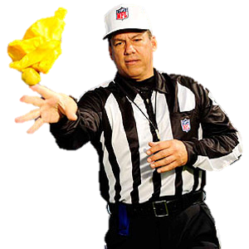
Unauthorized/Unnecessary
Name in bullet comments
Matt Forte demonstrated exceptional performance as the tailback
Use of present tense
proved he is the best corner playing the game
executes at a fast pace on every play
Anything outside rating period*
won Super Bowl MVP for his performance in Super Bowl 50
proved himself a reliable fullback during the season
Technical jargon
served as an integral part of the Mike, Sam and Will team
Rater comment on potential
clearly a future league MVP
move to first string receiver

Slide 16
Unauthorized/Unnecessary
Capitalized words at beginning of Bullet
Exhibited exceptional speed and athleticism
Punctuation at End of Bullet
showed the will and determination of a champion.
Copy and Paste Bullets
same bullet on two NCOs rated by the same rater
pulling from bullets from online sources
Actions not closed (adjudication)
pending UCMJ or administrative actions (GOMAR)

Slide 17
Evaluation Bullets
Strong Bullets Contain:
Accomplishment with IMPACT (the so what?)
Without impact, it’s just a job description
Level of impact or SCOPE (How big/far-reaching?)
Level of impact “should” determine the level of award or rating
QUANTIFIABLE or QUALITATIVE content (How much/compared to?)
Numbers help highlight impact and scope when used correctly
Quality work can be described without numbers
Ensure bullets are in the appropriate blocks
You only get one semi-colon per bullet; use it wisely
No potential comments!

Slide 18
Example 1
o selected over four peers to serve as squad leader; ensured Soldier and mission requirements were meet with 100% success
o completed over 35 DA Select Honor Guard missions while serving as a member of the HRC Ceremonial Honor Guard Team
o earned an APFT score of 272; designed PRT for his squad that resulted in a squad average of 256
What box check would you recommend?
FAR EXCEEDED EXCEEDED MET DID NOT MEET
STANDARD
STANDARD
STANDARD
STANDARD
X

Slide 19
Example 2
o recognized by the Installation Commander for contributions during the Fort Knox Centennial Week
o lead by example; motivated others to take pride in performance and instilled confidence in customer interaction
o remained flexible and mission-focused in an ever-changing environment and high operational tempo
What box check would you recommend?
FAR EXCEEDED EXCEEDED MET DID NOT MEET
STANDARD
STANDARD
STANDARD
STANDARD
X

Slide 20
Example 3
o imaged 9,849 laptops in 14 days and distributed to seven recruiting brigades located around the world
o designed guidelines of customer support for his team; resulted in a 95% success rate
o maintained positive control of over $320,000 worth of equipment
What box check would you recommend?
FAR EXCEEDED EXCEEDED MET DID NOT MEET
STANDARD
STANDARD
STANDARD
STANDARD
X

Slide 21
Evaluation Senior Rater Comments
Strong Comments Contain:
Enumeration: # of # or top ## percent of…
Senior rater professional opinion
Potential
Use narrative to capture the rater’s enthusiasm (or lack of) for the NCO; this reinforces the box checks
Recommend education, promotion, and assignment (3-5 years out)
The overall evaluation should create a WORD PICTURE for the reader
Board members often refer to NCOERs as the most important element of the board file
Assessment of Overall Potential:
MOST QUALIFIED: strong potential for selection ahead of peers
HIGHLY QUALIFIED: strong potential for selection with peers
QUALIFIED: capable of success at next level; promote if able
NOT QUALIFIED: not recommended for promotion

Slide 22
Example 1
#1 of 7 SSG’s I senior rater; a leader who out performs his peers and operates grades above his current, promote to Sergeant First Class right now. Has propensity to excel in any Generating, Operating, or Joint organization. Send to Signal Digital Masters Gunnery Course; to further his intellect and drive challenge this agile leader with an assignment with the White House Communications Agency as a team lead.
What box check would you recommend?
MOST HIGHLY QUALIFIED NOT
QUALIFIED
QUALIFIED
QUALIFIED
X

Slide 23
Example 2
#4 of 7 SFCs I currently senior rate and in top 20% of all SFCs that I’ve served with in my 17 years of service. Selected for Master Sergeant, send to MLC and assign as a First Sergeant when positions are available. Has potential to serve exceptionally well in strategic assignments.
What box check would you recommend?
MOST HIGHLY QUALIFIED NOT
QUALIFIED
QUALIFIED
QUALIFIED
X

Slide 24
Example 3
SFC ______ is an exceptionally technically skilled leader. Has drive and motivation to complete tasks asked of him. Displays relentless devotion to assist others while still completing mission requirements. Send to Master Leaders Course when seats are available and promote to MSG as needed.
What box check would you recommend?
MOST HIGHLY QUALIFIED NOT
QUALIFIED
QUALIFIED
QUALIFIED
X

Slide 25
NCO Lens (reviewing)
Army writing will be clear, concise, and effective
Must aid effective communication and decision-making
Provide readers with an understanding of the writer’s ideas in a single reading
Free of errors in substance, organization, style, and correctness
Avoid jargon (military or technical)
Place the main point up front and use active voice
Subject – verb – object
Emphasizes the actor (subject)
Results in shorter sentences
Passive voice: The test was passed by SGT Jones
Active voice: SGT Jones passed the test.

Slide 26
Award Write-ups & Levels
Strong write-ups contain:
Accomplishment with IMPACT (the so what?)
Without impact, it’s just a job description
Level of impact or SCOPE (How big/far-reaching?)
Level of impact “should” determine the level of award or rating
QUANTIFIABLE or QUALITATIVE content (How much/compared to?)
Numbers help highlight level of impact and scope when used correctly
Quality work can be described without numbers
Minimum Approving Authority:
AAM – approving authority BN Commander
ARCOM – approving authority BDE Commander
MSM – approving authority CG
LM – approving authority CG (next higher)

Slide 27
Example 1
____ was responsible for the operation and maintenance of two Standardized Tactical Entry Point (STEP) and three Regional Hub Node (RHN) antennas. Providing over 180 mission critical satellite links to users throughout nine countries within the CENTCOM AOR. _____ conducted the seamless RIP of three divisions, four brigades and 20 battalions, in direct support of OPERATIONS INHERENT RESOLVE (OIR) and SPARTAN SHIELD (OSS), ensuring all impacted mission critical RHN links remained operational.
What type award would you recommend?
Impact (So What?) =
Level (How big/far-reaching?) =
Quantity/Quality (How much/compared to?) =
MSM

Slide 28
Example 2
_____monitored and administered network systems, and software as an S-6 Specialist for the ____ Signal Battalion. ____ ensured that all systems were in compliance with Army Regulation 25-2 and the local Network Enterprise Center policies. ___ aggressively identified and eliminated system vulnerabilities on a monthly basis. Conducted regular security, vulnerability, and anti-virus scans on 122 network computers and all network devices. Implemented Microsoft Security updates and IAVA updates on a weekly basis.
NONE…
What type award would you recommend?
Impact (So What?) =
Level (How big/far-reaching?) =
Quantity/Quality (How much/compared to?) =
AAM

Slide 29
Example 3
________ expertly enabled Mission Command on multiple occasions for __ ABCT, in its organic form and as a Combined Joint Task Force with Air Force, Marines, and our NATO allies. He installed, operated, and maintained these enabling systems, and persevered through multiple integration and coordination challenges. Ultimately, __________’s efforts led to mission success every time.
NONE…
What type award would you recommend?
Impact (So What?) =
Level (How big/far-reaching?) =
Quantity/Quality (How much/compared to?) =
NONE…
ARCOM

Slide 30
Example 4
____ directly enabled the _BCT, ___ Brigade Support Battalion to achieve a 95% operational readiness rate by establishing the standard for Unit Level Logistics System-Ground (ULLS-G) and Unit Level Logistics System-S4 (ULLS-S4) conversions. His efforts not only led to success for the brigade, but that system was later implemented by the division to establish an overall 98% operational readiness during its NTC rotation.
What type award would you recommend?
Impact (So What?) =
Level (How big/far-reaching?) =
Quantity/Quality (How much/compared to?) =
MSM

Slide 31
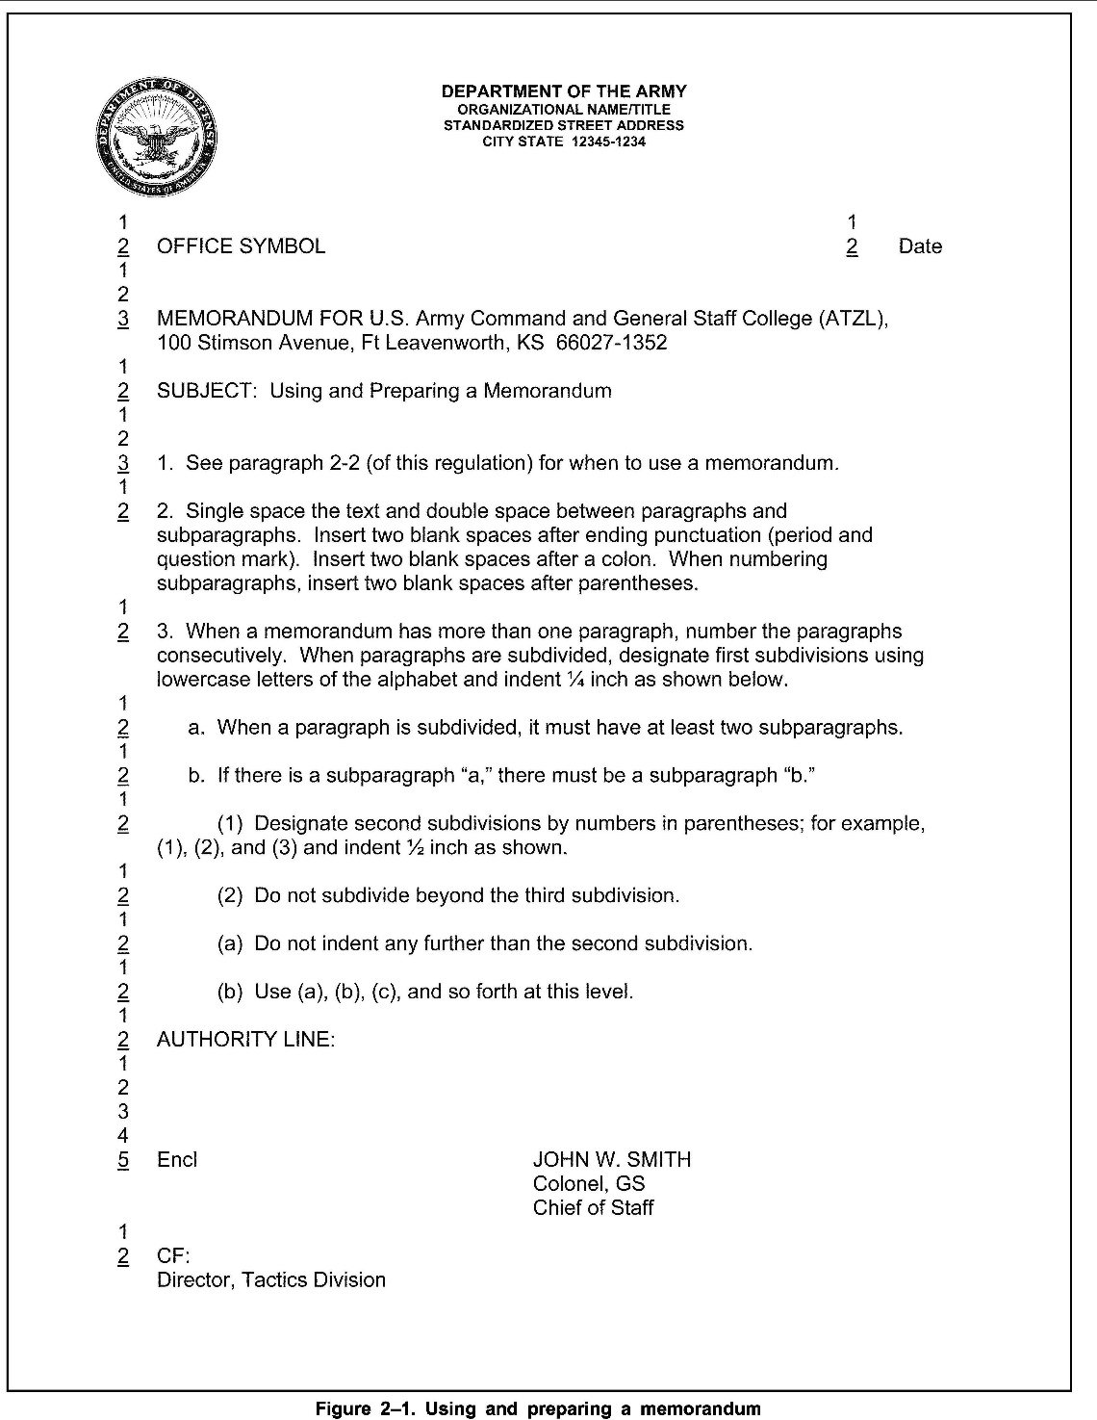
Memorandums

Slide 32
Electronic Mail
Know who you are sending an email to
Think twice before using “reply all”
Digitally sign an email if you have attachments, links, etc. in it
Encrypt an email if it has FOUO, PII, other sensitive information
Do not put PII or other sensitive information in the subject line
Auto replies
Electronic messages generated by Army personnel (military and civilian) in their official capacity will not contain slogans, quotes, or other personalized information as part of the individual sender's signature block.

Slide 33
Final Thoughts
Prior to selecting the award type, write the four bullets, then go back and read the award. The impact, scope, and quantification and/or quality of achievement/service should determine the type of award; NOT rank or position.
Prior to checking the boxes on an NCOER, complete the bullets and comments. Go back and assess the NCO appropriately based on what is written.
Keep a copy of the publications referenced here handy
Create templates that are correct, and use them
Know who your audience is

Slide 34
References
AR 25-50 Preparing and managing correspondence (2013)
AR 25-1 Army Information Technology (2019)
AR 600-8-22 Military Awards (2019)
AR 623-3 Evaluation Reporting System (2019)
DA Pam 623-3 – Evaluation Reporting System (2019)
HRC’s Enlisted Mock Board Video (2016)
armypubs.army.mil
https://www.youtube.com/watch?v=EF7cACxuUdg&feature=youtu.be

Slide 35
Questions

